Slide 1
ASSEMBLY LANGUAGE PROGRAMMING
CSE - 2214
prepared by Asma Enayet
Instructors
Asma Enayet
Lecturer
Dept. of CSE
University of Dhaka
Tahsin Aziz
Lecturer
Dept. of CSE
Ahsanullah University of Science and Technology

Slide 2
Contents
prepared by Asma Enayet
Recommended Text
Class Schedule
Computer Basics
A Typical computer
Work Flow of Computers
Programming Languages
Registers of an assembly language program

Slide 3
Recommended Text
prepared by Asma Enayet
Assembly Language Programming and Organization of the IBM PC
  by Charles Marut
Recommended Tool
Emu8086 – Microprocessor Emulator

Slide 4
Basis of Evaluation
prepared by Asma Enayet
Criteria | %
Attendance | 20
Continuous Evaluation | 30
Mid Exam | 25
Final Exam | 25
Total | 100

Slide 5
CHAPTER 1
prepared by Asma Enayet
Microcomputer Systems

Slide 6
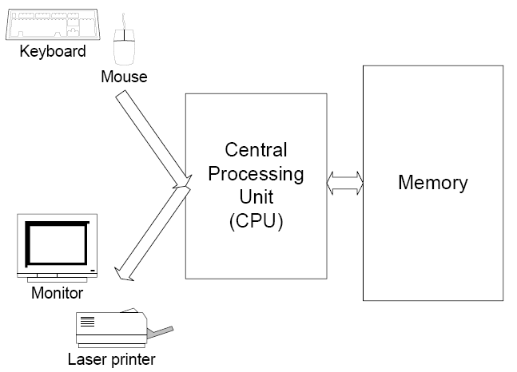
The Components of a Microcomputer
System
prepared by Asma Enayet
I/O

Slide 7
Memory
prepared by Asma Enayet
Information processed by the computer is stored In its memory
the memory circuits are usually organized Into groups that can store eight bits of data
A string of eight bits is called a byte. Two bytes form a Word.
Each memory byte circuit or memory byte is identified by a number that is called its Memory address.
The data stored in a memory byte are called its contents
Two kinds of memory
  RAM(random access memory)
  ROM(read only memory)

Slide 8
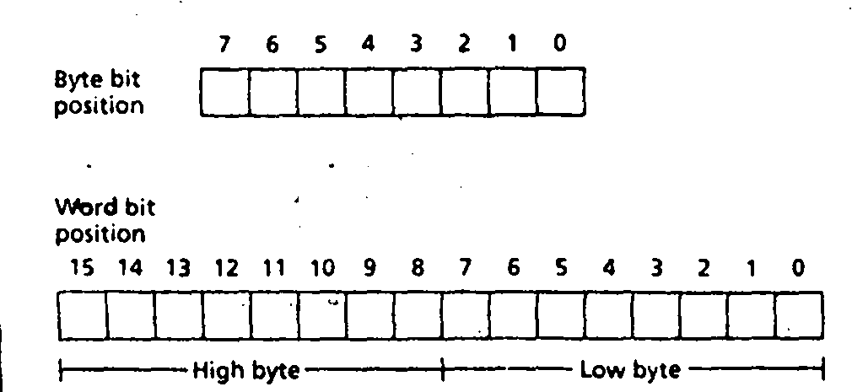
Bit position in a Byte and a Word
prepared by Asma Enayet

Slide 9
Buses
prepared by Asma Enayet
A processor communicates with memory and l/O circuits by using signals that travel along a set of wires or connections called Buses that
connect the different components.
There are three kinds of slgnals:.address, data, and control.
There are three buses: address bus; data bus, and control bus. For example, to read the contents of a mc.mory location, th~
CPU places the address oC the memory location on the address bus, and It
re<;elves the data, sent by tlie memory circuits, on the data bus, A control
signal l~ required to inform the memory to perform a read operation. The
CPU sends the control signal on the control bus. Figure 1.5 Is a diagram of
the bus connections for.a microcomputer. ·

Slide 10
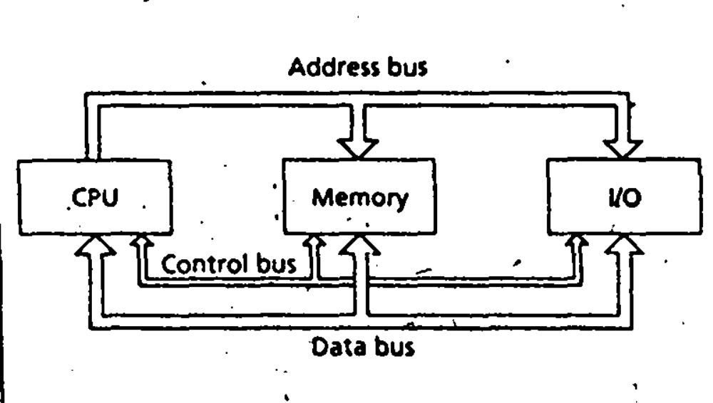
Bus connections
prepared by Asma Enayet

Slide 11
The CPU
prepared by Asma Enayet
controls the computer by executing programs stored in memory
The instructions performed by a CPU are called its instruction set.
Instruction set for each CPU is unique.
Two main components:
  Execution Unit (EU)
  Bus Interface Unit (BIU)

Slide 12
Execution Unit (EU)
prepared by Asma Enayet
Executes instructions
Contains Arithmetic ( + , - , * , / ) and logic (AND, OR, NOT) unit (ALU)
Register
  The data for the operations are stored in circuits called Registers.
  A register is like a memory location except that we normally refer to it by a name rather than a number.
  The EU has eight registers (16bit) for storing data;
    AX, BX, CX, DX, SI, DI, BP, and SP.
    Temporary registers for holding operands for the ALU
    FLAGS register whose individual bits reflect the result of a computation.

Slide 13
Bus Interface Unit
prepared by Asma Enayet
Communication media between the EU and the memory or I/0 circuits.
Transmits addresses, data, and control signals on the buses.
Its registers are named CS, OS, ES, SS, and IP; they hold addresses of memory locations.
The EU and the BIU. are connected by an Internal Bus
While the EU is executing an instruction, the BIU fetches up to six
bytes of the next instruction and places them in the instruction queue. This operation is called instruction prefetch.

Slide 14
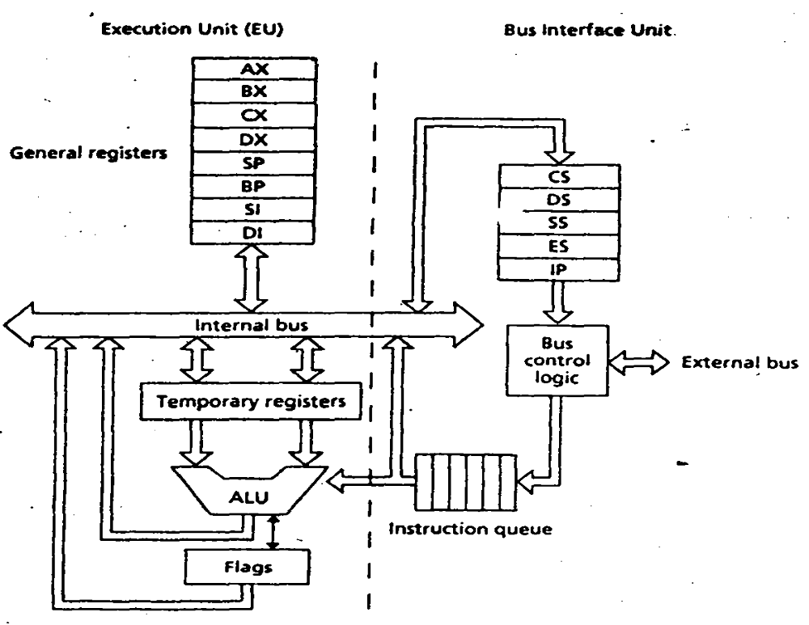
prepared by Asma Enayet

Slide 15
I/O Ports
prepared by Asma Enayet
I/O devices are connected to the computer through I/O circuits. Each of these circuits contains several registers called I/O ports.
Data to be Input from an I/O device are sent to a port where they can be read by the CPU.
On output, the CPU writes data to an I/O port. The I/O circuit then transmits the data to the I/O device.

Slide 16
Serial and Parallel Ports
prepared by Asma Enayet
Serial port
  Transfers one bit at a time
  Used for slower transfer such as keyboard.
Parallel port
  Transfers 8 or 16 bits at a time
  Requires more wiring connections
  Used for faster data transfer such as disk drives.

Slide 17
Programming Languages
prepared by Asma Enayet
Computer programs
      Sets of instructions which directs a computer to perform certain function.
Types:
Machine language
Assembly language
High-level languages

Slide 18
Machine language
prepared by Asma Enayet
Binary
Machine dependent
Stored in the computer when the program is running
A CPU can only execute machine language instructions - computer’s language
Example:
  01110110001010010010 ….

Slide 19
Assembly language
prepared by Asma Enayet
Symbolic addressing, i.e.,
  Use Symbolic names to represent operations, registers and memory locations.
One-to-one correspondence with machine language
A program written in assembly language must be converted to machine language before the CPU can execute it.
A program called the assembler translates each assembly language statement into single machine language instruction.

Slide 20
Example:
prepared by Asma Enayet
  MOV AX,A
  ADD AX,4
  STORE Z

Slide 21
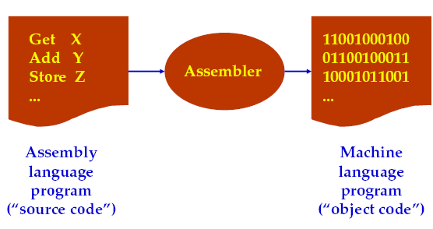
Automatically translating assembly language to machine language
prepared by Asma Enayet

Slide 22
High-level languages
prepared by Asma Enayet
Closer to how people think about their problems
No one-to-one correspondence to machine language
General purpose
Example:
  Z = A+ 4

Slide 23
High-level languages
prepared by Asma Enayet
Fortran
Basic
Visual Basic
C
C++
Java

Slide 24
Instruction Execution
prepared by Asma Enayet
Opcode
  the type of operation
Operands
  the data to be operated on

Slide 25
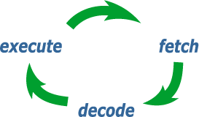
The fetch-execution cycle
prepared by Asma Enayet
Fetch
  Fetch an instruction from memory.
  Decode the Instruction to determine the operation.
  Fetch data from memory if necessary.
Execute
  Perform the operation on the data.
  Store the result in memory if needed

Slide 26

prepared by Asma Enayet
Computer Model
MOV AX, a
ADD AX, b
MOV x, AX
…
x ← a + b
Memory
a
010100110010101
CPU
Register
AX
b
110010110001010
BX
PC
...
x
000000000010010
ALU
+ -

Slide 27
prepared by Asma Enayet
Meanings of the Code (assumed)
Assembly code Machine code
MOV AX, a
(Take the data stored in
memory address ‘a’, and
move it to register AX)
ADD AX, b
(Take the data stored in
memory address ‘b’, and
add it to register AX)
MOV x, AX
(Take the data stored in
register AX, and move it to
memory address ‘x’)
01 0000001 1000010
MOV
register
address
AX
memory
address
a
11 0000001 1000110
ADD
01 1000011 0000001

Slide 28
Another Computer Model
prepared by Asma Enayet
Processor
Stored program architecture
Register
Memory
AX
…
BX
x
data
a
b
01 0000001 1000010
MOV AX, a
11 0000001 1000110
ADD AX, b
01 1000011 0000001
MOV x, AX
ALU
…
IR
PC
address
PC: program counter
IR: instruction register

Slide 29
Step 1: Fetch (MOV AX, a)
prepared by Asma Enayet
Register
Memory
AX
…
BX
x
data
a
b
01 0000001 1000010
MOV AX, a
11 0000001 1000110
ADD AX, b
01 1000011 0000001
MOV x, AX
ALU
…
IP
PC
01 0000001 1000010
0000111
address

Slide 30
Step 2: Decode (MOV AX,a)
prepared by Asma Enayet
Register
Memory
AX
…
BX
x
data
a
Controller
b
01 0000001 1000010
MOV AX, a
11 0000001 1000110
ADD AX, b
01 1000011 0000001
MOV x, AX
ALU
…
clock
IP
PC
01 0000001 1000010
0000111
address

Slide 31
Step 3: Execute (MOV AX,a)
prepared by Asma Enayet
Register
Memory
AX
…
00000000 00000001
BX
x
data
00000000 000000001
a
Controller
b
01 0000001 1000010
MOV AX, a
11 0000001 1000110
ADD AX, b
01 1000011 0000001
MOV x, AX
ALU
…
clock
IP
PC
01 0000001 1000010
0000111
address

Slide 32
Step 1: Fetch (ADD AX,b)
prepared by Asma Enayet
Register
Memory
AX
…
00000000 00000001
BX
x
data
a
b
01 0000001 1000010
MOV AX, a
11 0000001 1000110
ADD AX, b
01 1000011 0000001
MOV x, AX
ALU
…
IP
PC
11 0000001 1000110
0001000
address

Slide 33
Step 2: Decode (ADD AX,b)
prepared by Asma Enayet
Register
Memory
AX
…
00000000 00000001
BX
x
data
a
Controller
b
01 0000001 1000010
MOV AX, a
11 0000001 1000110
ADD AX, b
01 1000011 0000001
MOV x, AX
ALU
…
clock
IP
PC
11 0000001 1000110
0001000
address

Slide 34
Step 3a: Execute (ADD AX,b)
prepared by Asma Enayet
Register
Memory
AX
…
00000000 00000001
BX
x
data
a
Controller
00000000 00000010
b
01 0000001 1000010
MOV AX, a
+
11 0000001 1000110
ADD AX, b
01 1000011 0000001
MOV x, AX
ALU
…
00000000 00000011
clock
IP
PC
11 0000001 1000110
0001000
address

Slide 35
Step 3b: Write Back (ADD AX,b)
prepared by Asma Enayet
Register
Memory
AX
00000000 00000011
00000000 00000001
…
BX
x
data
a
Controller
b
01 0000001 1000010
MOV AX, a
11 0000001 1000110
ADD AX, b
01 1000011 0000001
MOV x, AX
ALU
…
00000000 00000011
clock
IP
PC
11 0000001 1000110
0001000
address

Slide 36
Advantages of Assembly languages
prepared by Asma Enayet
Efficient
  It is so close to machine language.
  Produces a faster, shorter machine language program.
Some operations, such as reading or writing to specific memory locations and I/O ports can be done easily in assembly language but may be impossible at a higher level.
It also provides the way to realize how the computer “thinks” and performs the inner operations.

Slide 37
prepared by Asma Enayet
Thank You

